Slide 1

Artificial Intelligence project report
Group 20
Pierre BOUTRY, Dan DOLONIUS, Julien MICHELET, Emeric ROVERC'H
21/05/2014

Slide 2
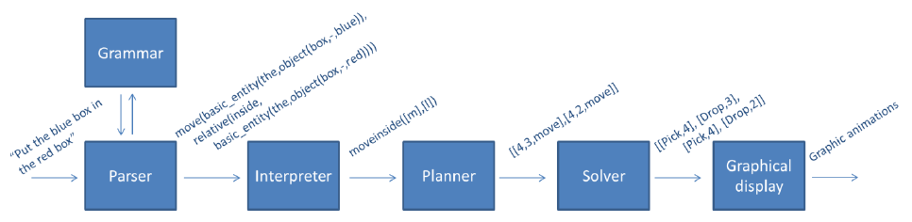
Presentation of the application
Simple client-server architecture
On server side: Parser, Interpreter, Planner, Solver
On client side: Collect of the query and graphical display

Slide 3
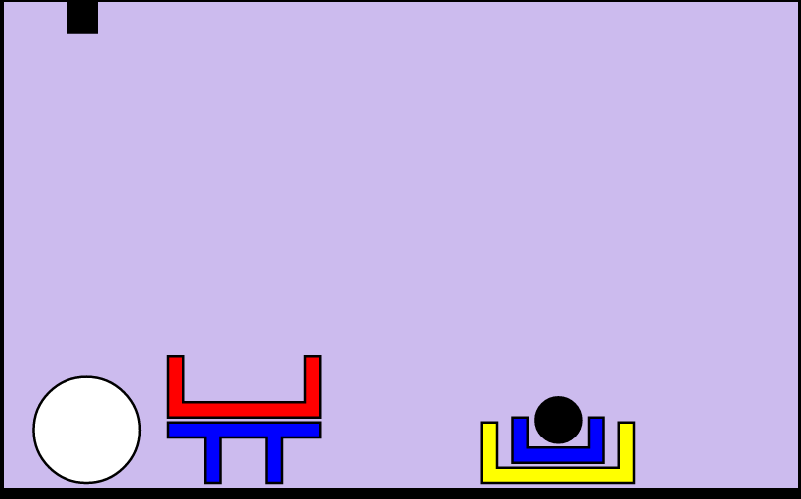
The world
The world can contain objects of different forms, colours and sizes:
Forms: bricks, planks, balls, pyramids, boxes, tables.
Colours: red, black, blue, green, yellow, white.
Sizes: large, medium, small.

Slide 4
Grammar
The major improvements is the possibility for the user to ask 3 new types of questions: where, what and count.
For example:
“where is the white big ball?”
“what are the object in the world?”
“how many ball are in the world?”
The user can also perform request about stacks
“what are the objects in stack 2?”

Slide 5

Interpreter – interpretation rules (1/2)
We make a set of rules to recursively satisfy every node in the tree, e.g:
We implemented a set of 62 rules to:
Get object satisfying description.
Handle the any or all cases for basic entities.
Get object which satisfies relation to "object X".
Get object which satisfies relation to stack.
Process output to goal.

Slide 6

Interpreter – interpretation rules (2/2)
Further, we have some rules to see if an object is e.g. besides any other object
We also added rules to support the new count, where and what questions.

Slide 7



Interpreter - Quantifiers
The quantifiers allow the robot to handle query such has
“put any ball in the red box”.
The quantifier function uses cuts to choose one possible action
A cut (!) in prolog is a way to restrict the search by “fixing” the variables
Here is an example, we define:
and
For bar
For bas
For bac

Slide 8
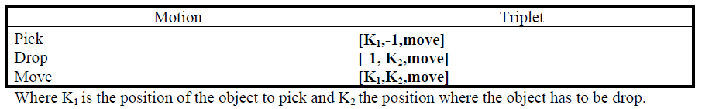
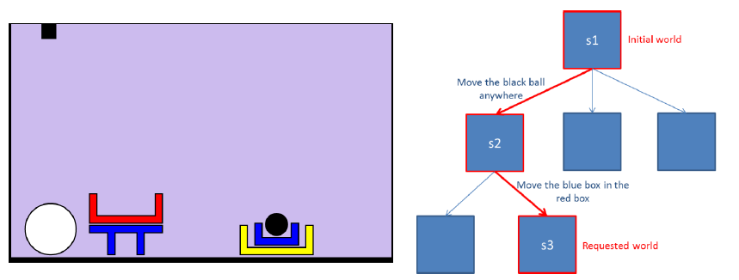
Planner
The planner takes a query as an input and build list of triplets
Here is an example for a complex case:
“Put the blue box in the red box”.
And the output of the planner is: “Plan = [[4,3,move],[4,2,move]] ”

Slide 9
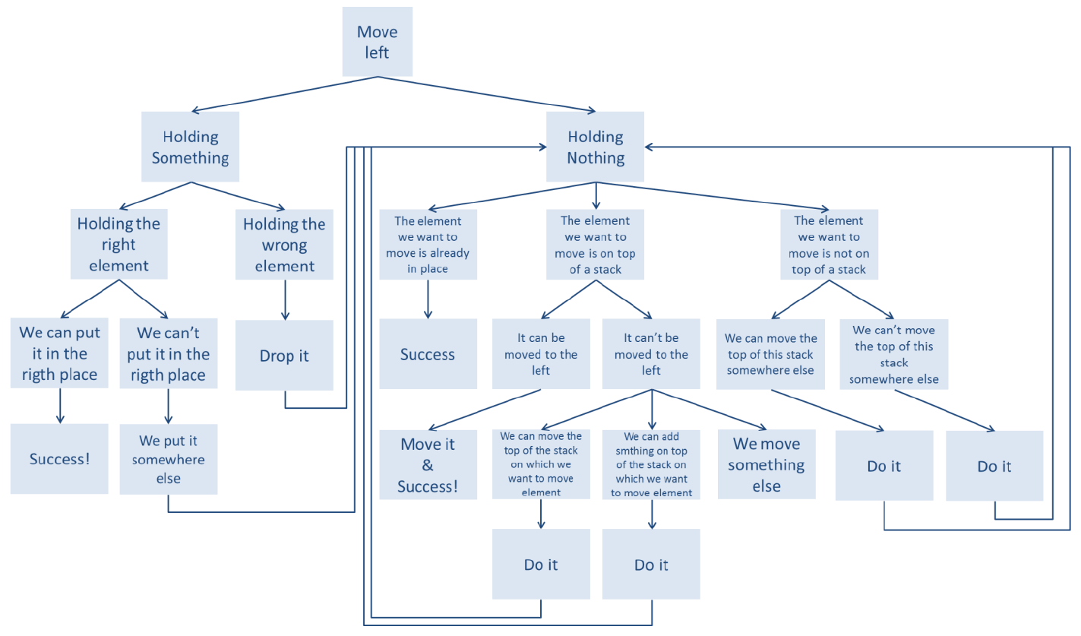
Planner - Heurisitic
The heuristic allows the robot to handle complex cases in a smarter way
For example, in case of a move left query:

Slide 10
Ambiguities handeling
Allows the robot to ask question if a query is not clear enough
For example, in the world below:
“what is under the box?”
The machine would ask for more information
“What box ?”
The user will then have to specify his query
“The big red box”

Slide 11
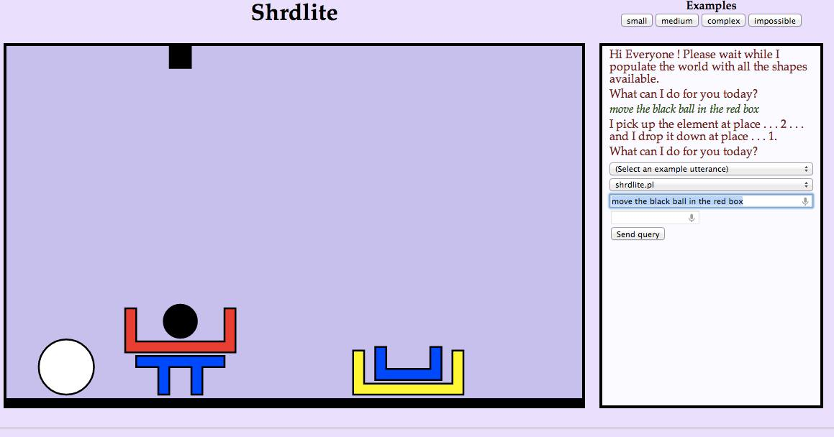
Output
The output is a web interface developed in html and javascript.
All actions are represented with the SVG (Scalable Vector Graphics) library
The web client picks up results by means of an ajax request
“what is under the box?”

Slide 12
Benchmark - Measuring efficiency

Slide 13

Questions

